Slide 1



UNIVERSITY INSTITUTE OF ENGINEERING
COMPUTER SCIENCE& ENGINEERING
Bachelor of Engineering
Robotics Process Automation(20CST-472)
Prepared By: Ms. Jyoti Chandel(E15580)
Topic: Key steps in implementing RPA projects.
DISCOVER . LEARN . EMPOWER

Slide 2
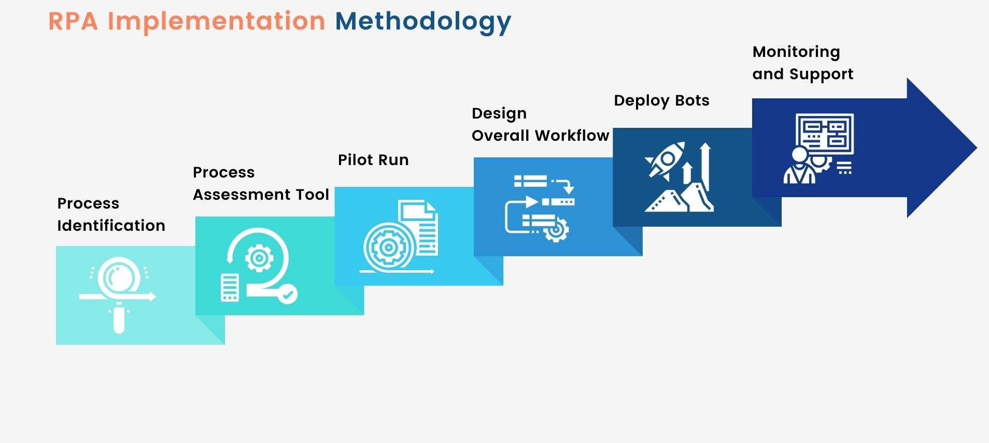
RPA Implementation Process

Slide 3
What is RPA (Robotic Process Automation) Implementation?
Robotic process automation implementation allows businesses and organizations to automate different, often menial, mundane, and rule-based tasks across applications and systems that would otherwise fall under the scope of human responsibility. In short, RPA implementations aim to transfer process execution from humans to software bots.
When deployed, RPA technology interacts with your organization’s existing architecture without requiring complex system integrations or labor-intensive process automation, such as data entry, file manipulation, and data validation.
RPA implementation technology offers a wide range of benefits for your business or organization, including reduced operational costs, improved accuracy, decreased errors, and increased efficiency. By automating repetitive and rule-based processes, you give your employees more time for higher-value work.

Slide 4
Common Challenges in the RPA Implementation Process
Despite the many benefits of RPA, the implementation process can be challenging. It’s important to understand the challenges and prepare adequate strategies for dealing with each one. Here are some of the key challenges businesses and organizations face during the RPA implementation process:
Reluctance — Reluctance, or resistance to change, is one of the most common challenges associated with RPA implementation. Your employees might be hesitant to embrace new technologies, fearing that their jobs might be at risk. Therefore, it’s important to communicate the various benefits of RPA implementations to your employees and involve them in the implementation process to help them overcome their reluctance and resistance to change.
Process Standardization — RPA implementations require the standardization of processes taking place within your organization’s operations to automate effectively. Without standardization, the RPA implementation can be both challenging and time-consuming. So, it’s a good idea to standardize your organization’s operational processes before implementing RPA technology.

Slide 5
Common Challenges in the RPA Implementation Process
Technical Complexity — Depending on the architecture, the RPA implementation can be technically complex, requiring expertise in areas such as programming, data analysis, and system integration. This can prove challenging for organizations that lack technically proficient staff with the necessary technical skills. If you are worried about the technical complexity of implementation at your organization, it’s best to work with a reputable vendor and establish a Center of Excellence (COE) that can provide technical guidance.
Change Management — RPA implementations often require and result in significant changes in the organization’s workflows, processes, and systems. This can be challenging for organizations that lack a structured approach to change management. It’s important to develop a change management plan that includes communication, training, and stakeholder engagement.
Security and Compliance — RPA software bots often require access to sensitive data, which raises security and compliance concerns. To avoid potential legal issues, it’s crucial to establish adequate security protocols to protect the data and ensure compliance with industry standards.

Slide 6

Common Challenges in the RPA Implementation Process
Security and Compliance — RPA software bots often require access to sensitive data, which raises security and compliance concerns. To avoid potential legal issues, it’s crucial to establish adequate security protocols to protect the data and ensure compliance with industry standards.
Scalability — Scalability of RPA implementations can be challenging, especially if your organization has many processes that need to be automated. Choosing an RPA solution that can be easily scaled is crucial, and establishing a process that would prioritize other automated processes is vital.
Maintenance — RPA requires ongoing maintenance to ensure the technology continues operating efficiently. However, this can be challenging for organizations lacking the necessary resources. That’s why it’s important to establish a maintenance plan and work with a vendor that offers comprehensive maintenance and support.

Slide 7
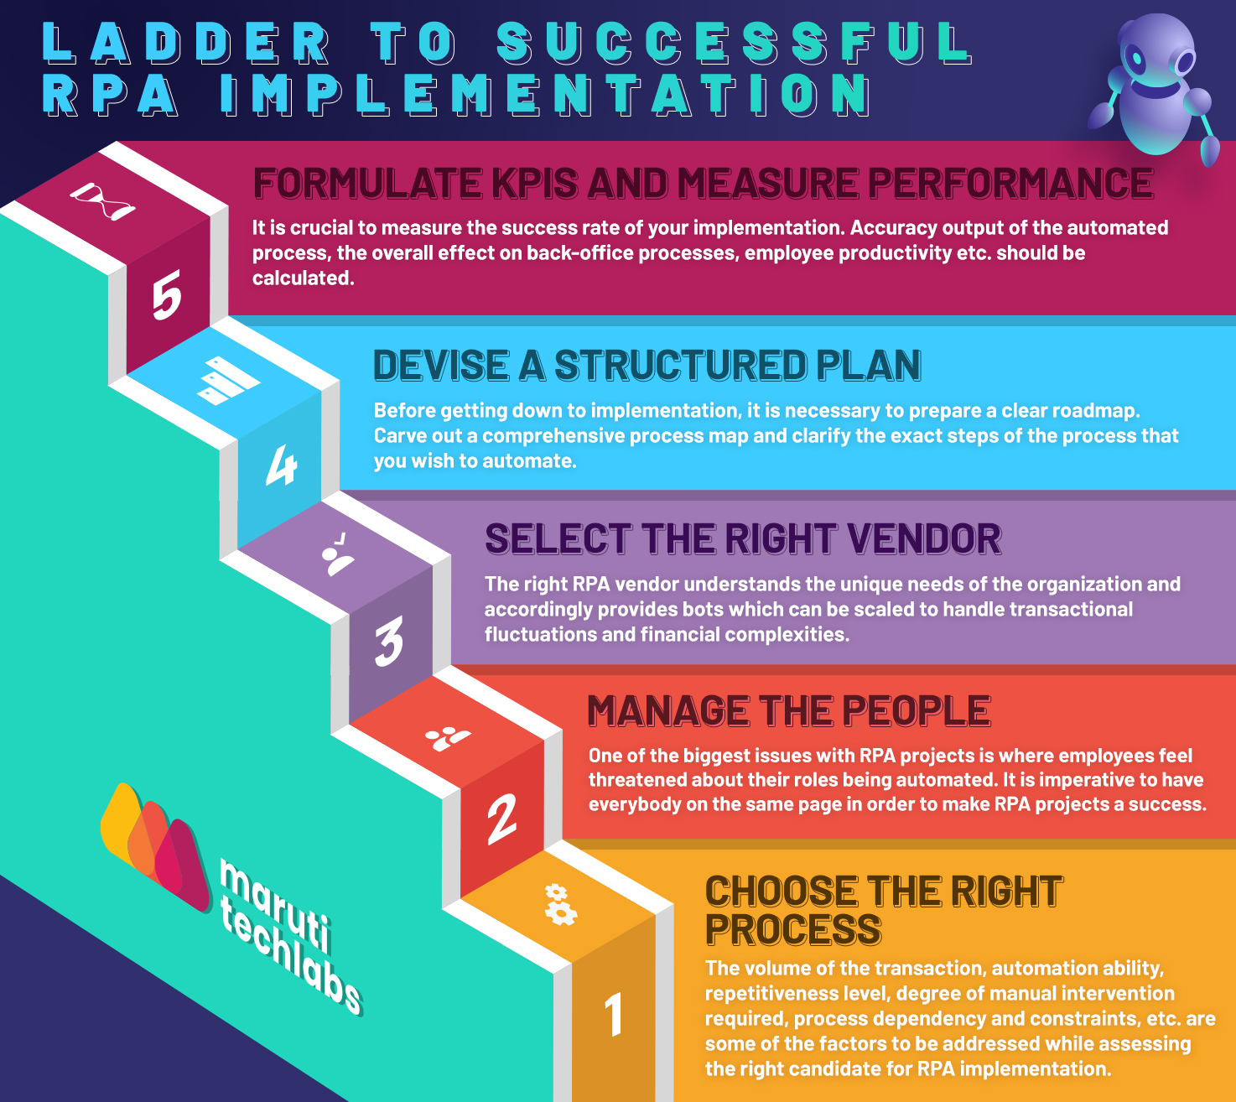

Slide 8

Steps for a Successful RPA Implementation
A well-prepared and structured RPA implementation approach helps you take full advantage of the technology and its numerous benefits. To help ensure a successful RPA implementation with Ranorex, adhere to the following RPA implementation methodology:
1. Begin Planning and Assessing Your Situation and Needs
It’s important to clearly understand your organization’s current status and your goals regarding RPA before the implementation process begins. This includes assessing your existing processes, identifying which areas to automate, and determining the actual level of automation required. This is why it’s important to standardize your processes prior to RPA implementation.

Slide 9
Steps for a Successful RPA Implementation
2. Identify Valuable Processes to Maximize With Automation
The point of RPA is to automate manual, repetitive, and time-consuming processes, but to do so, you must first identify which processes to automate. Conducting a thorough analysis of your organization’s workflow and associated processes can help you identify and prioritize processes that carry high business value and whose efficiency could be maximized through automation.
3. Decide on Your RPA Sponsor and Vendors
Choose a vendor with a comprehensive RPA solution and a proven track record. Then, consider various factors, such as the functionality of the RPA solution the vendor offers, the level of support the vendor provides, and the vendor’s experience with similar implementations.
When choosing a sponsor, choose someone who can advocate for the implementation, secure funding and support, and lead the RPA implementation process. This should be a senior executive or someone who can help overcome challenges, such as resistance to change, and who can align the RPA implementation with the company’s business goals.

Slide 10
Steps for a Successful RPA Implementation
4. Establish a Center of Excellence (COE)
A COE is a team of skilled and knowledgeable experts who provide guidance and support to other groups in your organization. This team usually consists of project managers, business analysts, IT specialists, RPA developers, and other individuals with subject matter expertise that they use to support others. The COE should also be responsible for developing the best practices and standard operating procedures for RPA implementation.
5. Ensure Your Systems are Secure
Choosing the right RPA solutions vendor is very important; the right vendor will ensure that your systems are secure and that your RPA implementation complies with all applicable regulations. This is particularly important if your RPA requires access to and handles sensitive data. Establishing appropriate security and data protection protocols is imperative for ensuring that your data remains protected.

Slide 11

Steps for a Successful RPA Implementation
6. Create a Proof of Concept (PoC)
PoC is a small-scale implementation of RPA technology used to test its viability for your unique business needs and identify potential problems. In short, it has a dual purpose: it demonstrates the value of the implementation to stakeholders to secure funding, and it allows the business to test the RPA and address potential issues before proceeding with a full-scale implementation.
7. Run a Pilot Program
Once you’ve created the PoC, it’s time to move on to the RPA trial run. This includes selecting and automating a small group of processes identified as good automation candidates. Deploying a pilot further reduces bot deployment inefficiencies and helps you gain insight into whether you’re investing in the right processes. Finally, evaluating the performance of the RPA pilot against predefined success criteria and against manual execution of the same processes helps to further ensure successful organization-wide implementation.

Slide 12
8. Track Performance and Operations
Tracking and evaluating the performance of your RPA implementation is crucial to understanding the implementation’s impact on your organization and proving its worth. The best way to do this is to collect that data on the number of tasks successfully completed by the RPA bots, the cumulative execution time, and the number of errors. Then, compare that data against the same number of processes executed manually to gain insight into the time saved and the errors reduced.
Furthermore, this data can be used to compare the performance of your RPA implementation against itself as you continue to identify areas and processes which can be further optimized and automated. This will allow you to fine-tune your RPA implementation and maximize its effectiveness.

Slide 13
Benefits of Using RPA Implementation Technology
Implementing RPA technology offers a wide range of benefits, including elevated employee engagement, faster time to market, and increased revenue. However, there are other benefits that make RPA technology well worth the money:
Improved Productivity — By automating repetitive and/or menial tasks, your employees can now focus on higher-value work. When it comes to software development, improved productivity can lead to the reduction of technical debt.
Enhanced Accuracy — RPA automation reduces or eliminates the human factor, which, assuming proper implementation, reduces the risk of errors and improves overall reliability.
Reduced Costs — RPA technology cuts costs by increasing process efficiency and reducing the need for time-consuming manual labor.
Greater Scalability — RPA technology is easily scalable, making it ideal for growing businesses.

Slide 14
References
Websites:
https://www.ranorex.com/blog/rpa-implementation-an-8-step-guide-for-success/

Slide 15
THANK YOU

